Slide 1
FRB Update #32
William Huang
(08/29/2021)

Slide 2
k=3 data

Slide 3
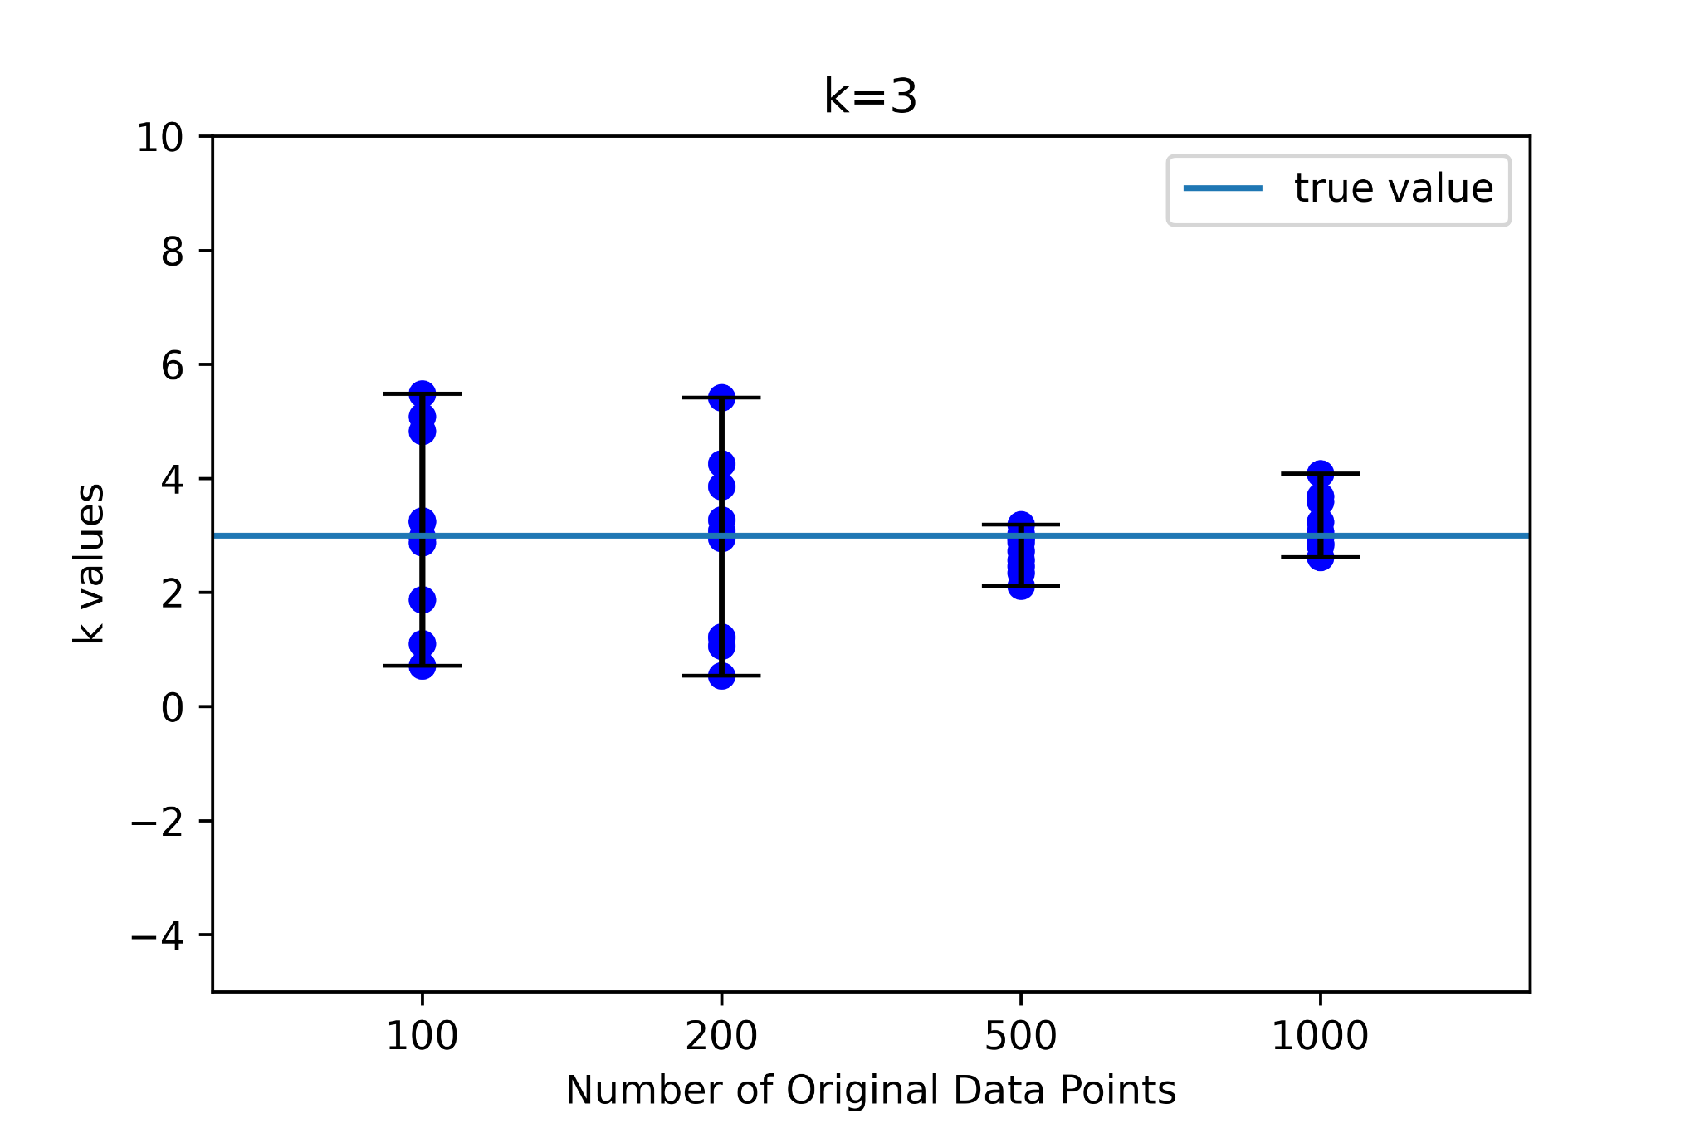
k=3 samples
A set of 10 random samples were run with lognormal distributions in z, and log random distributions in E, for original number of data points 100, 200, 500, and 1000. The resultant k values compared to true values are shown on the right.

Slide 4
How many k values obtained by Kendall Tau are greater than raw fit?
For k=3:
sample size 100: 2/10
sample size 200: 1/10
sample size 500: 0/10
sample size 1000: 0/10

Slide 5
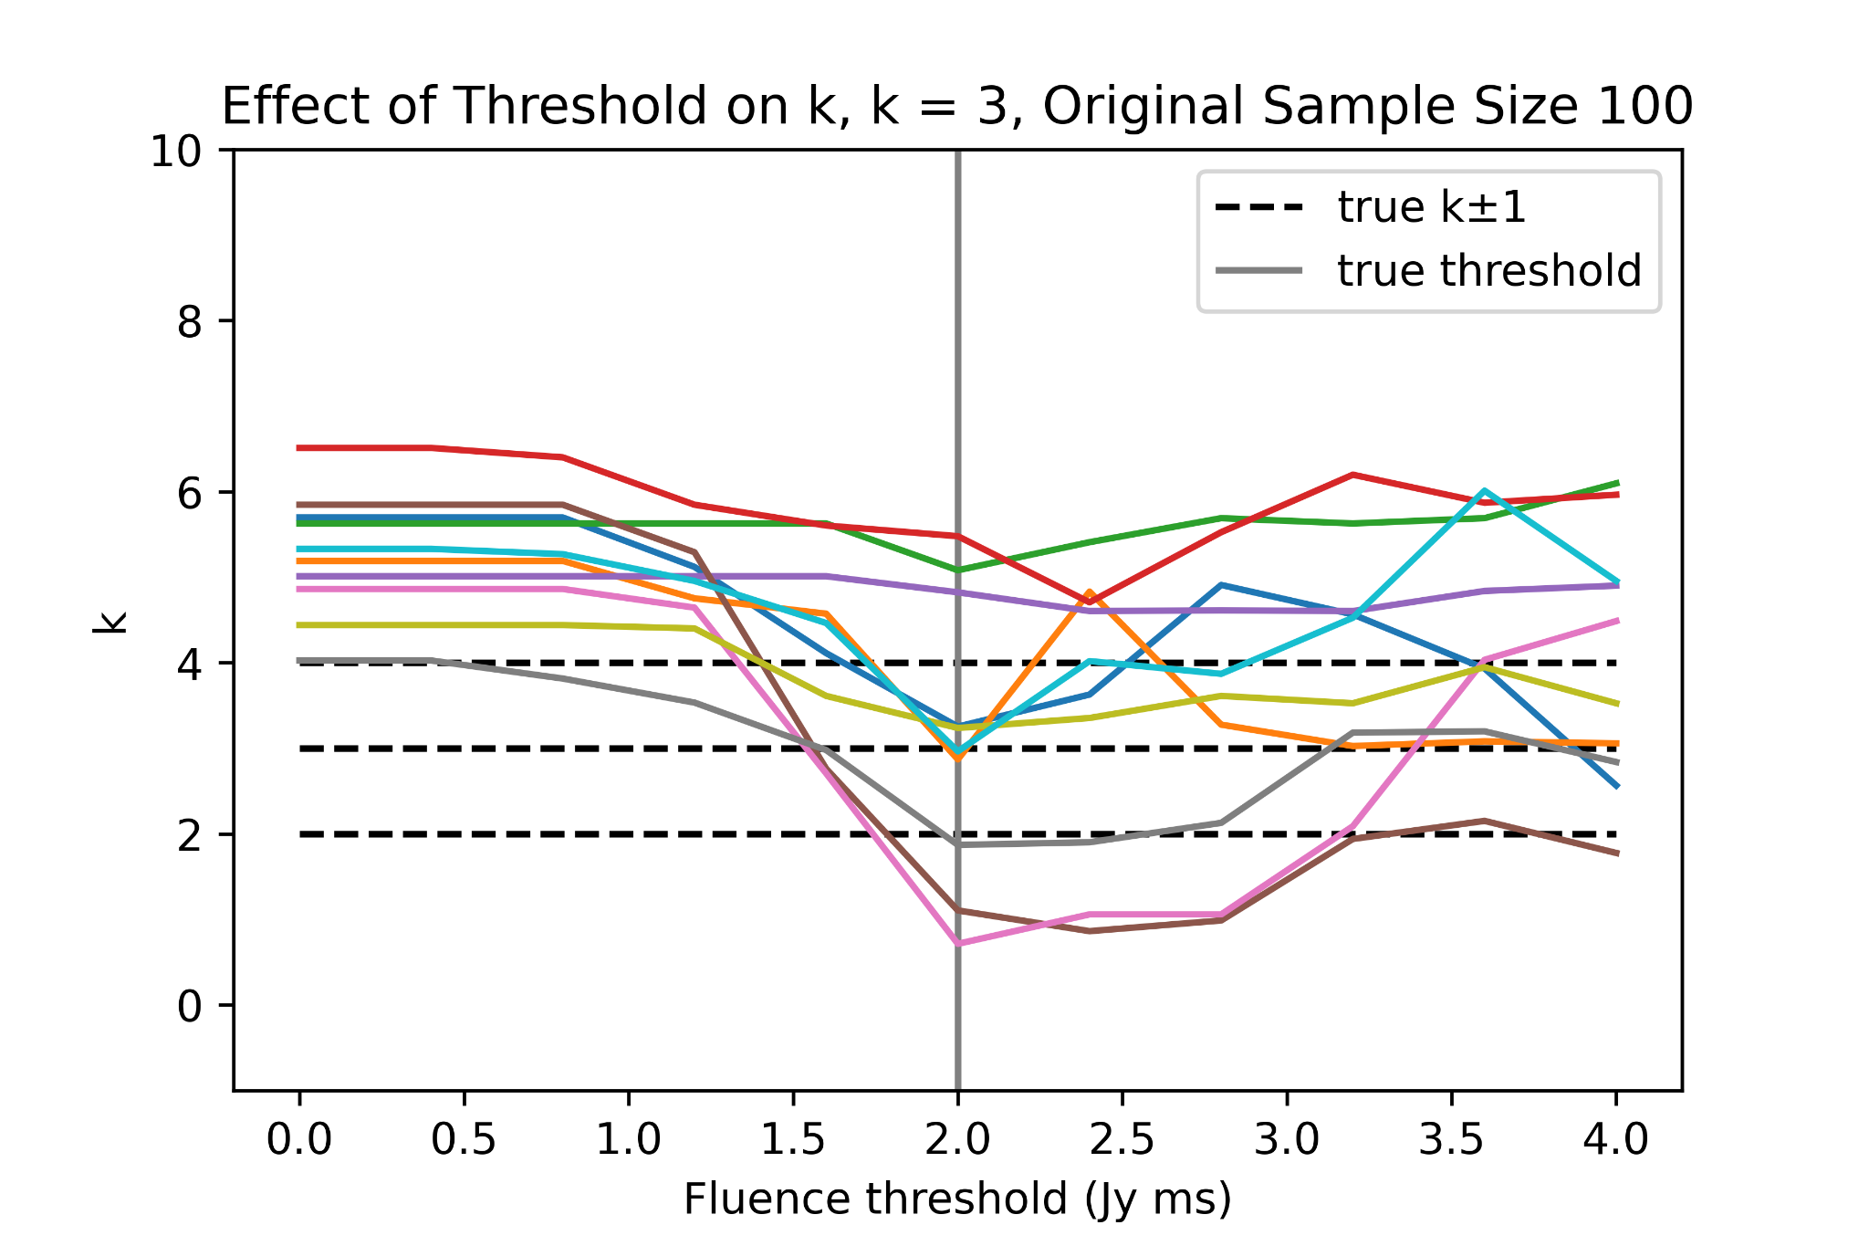
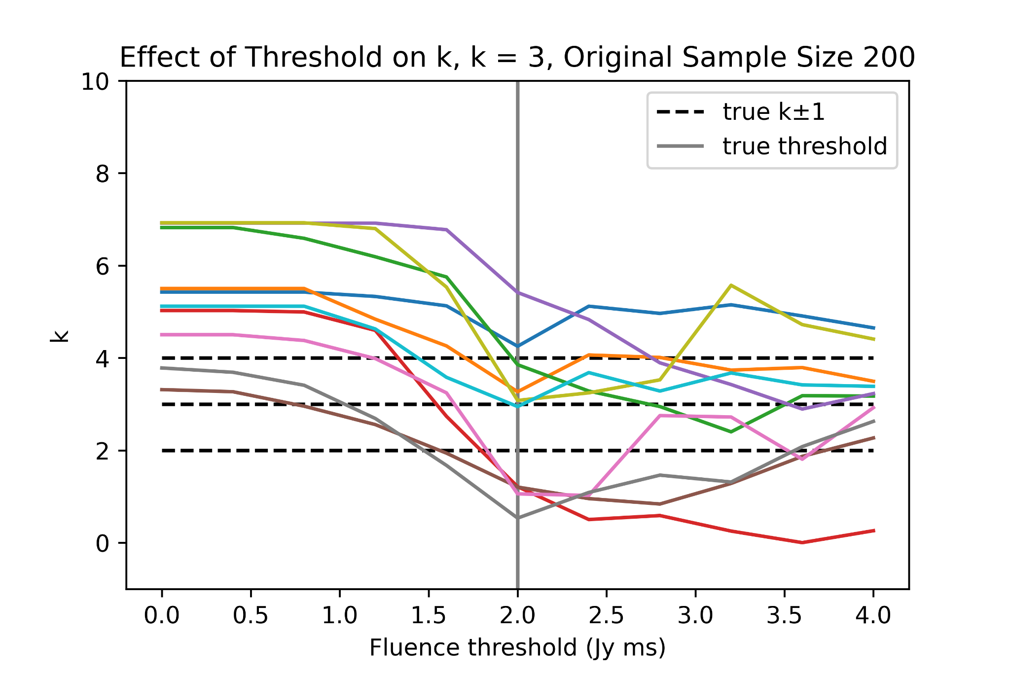
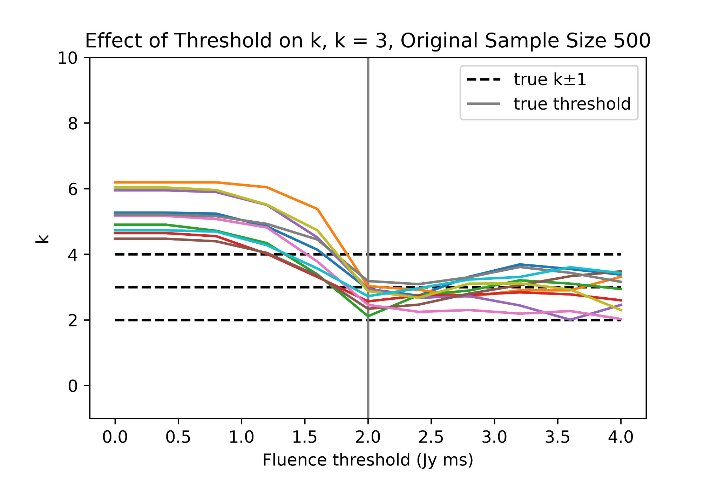
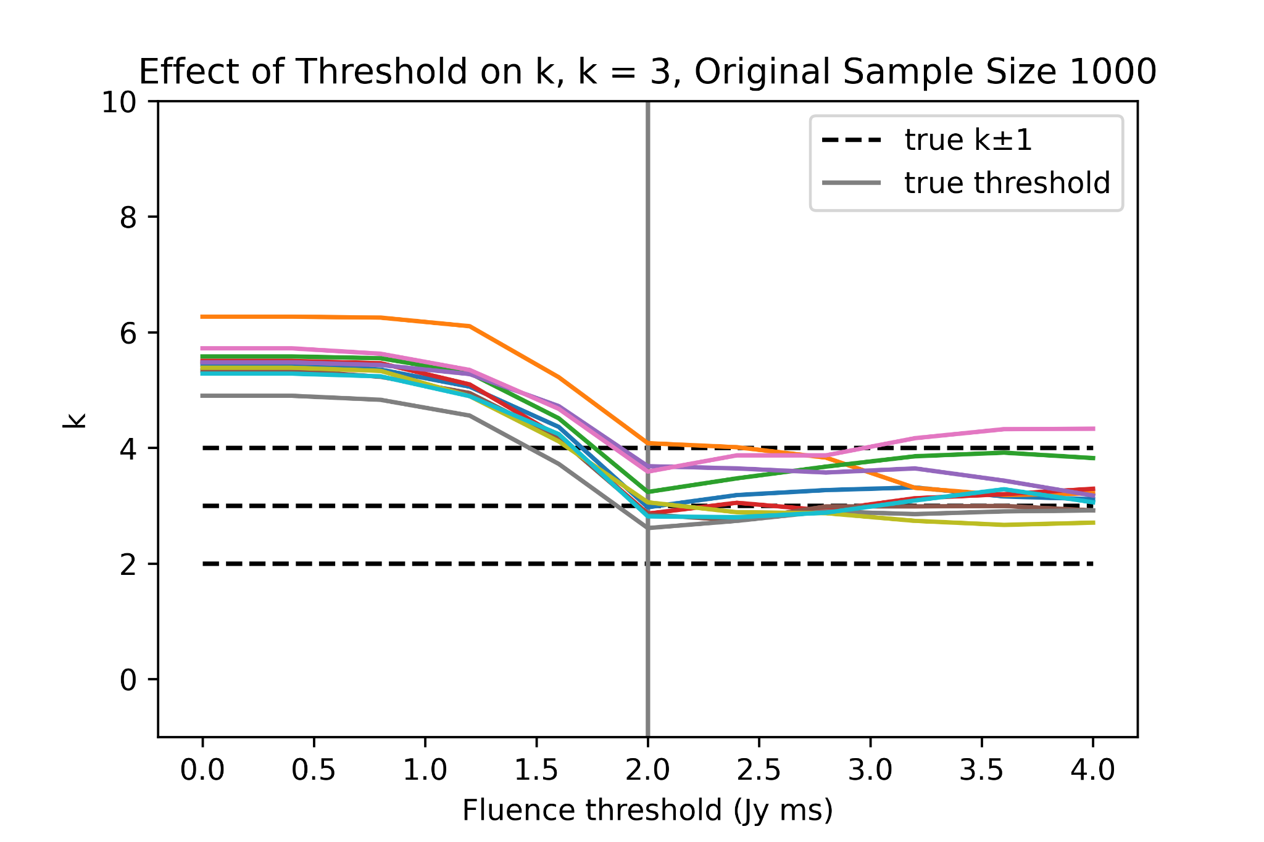
2. Assuming a lower fluence threshold, when does the result become unacceptable?
For k=3:
For each sample size, the threshold was varied to see the variation in k. Generally, higher fluence thresholds than the true value preserve k but lower values result in increasing k, becoming unreasonable at around 1.5 Jy ms.

Slide 6
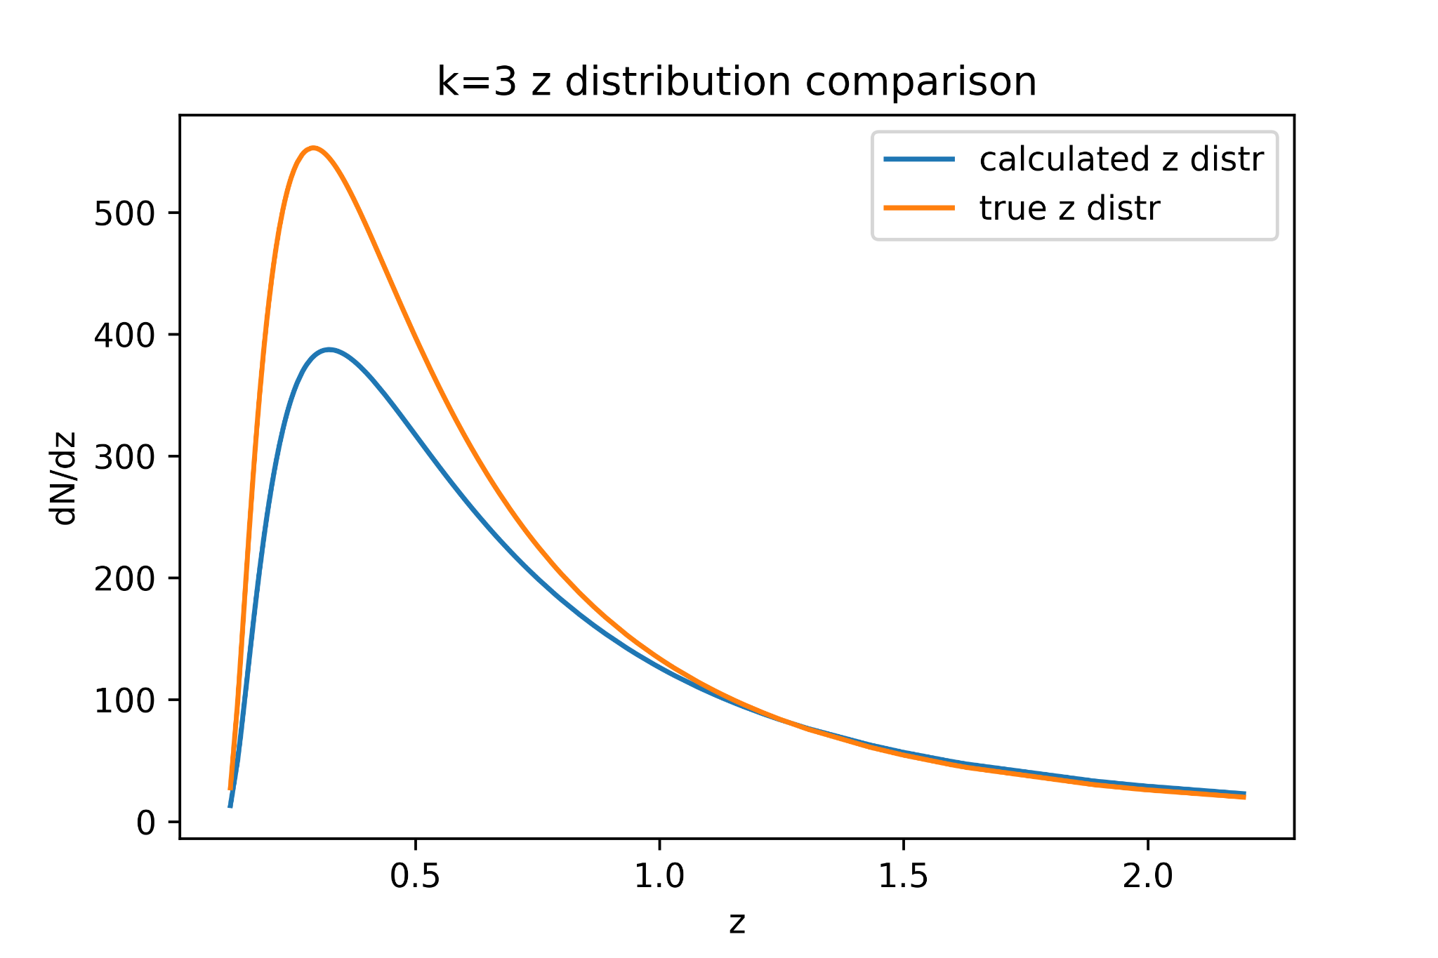
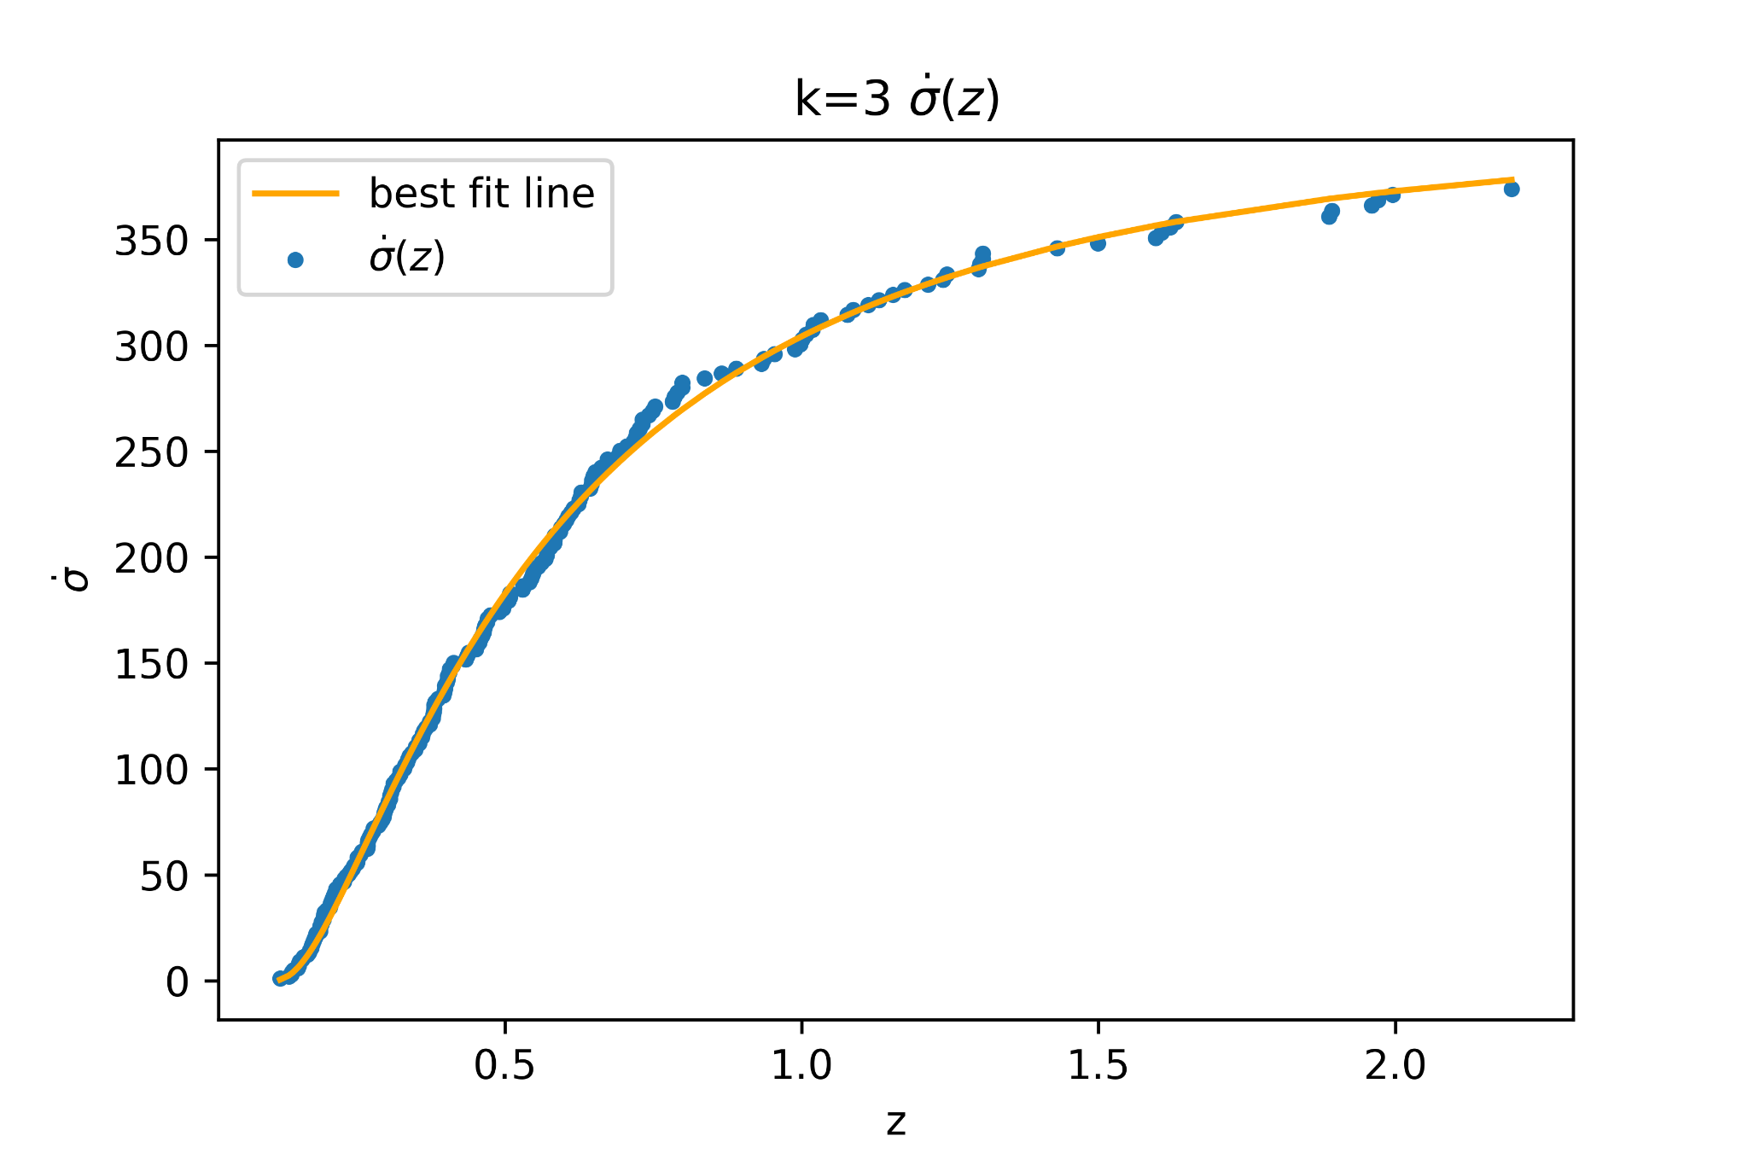
3. How does calculated z, E distributions compare?
Here, one sample of 500 original data points was further analyzed to determine the z and E distributions. Below, the z distribution is pretty similar in shape, and only different in scale (the calculated distribution predicts less total points than the true distribution).

Slide 7
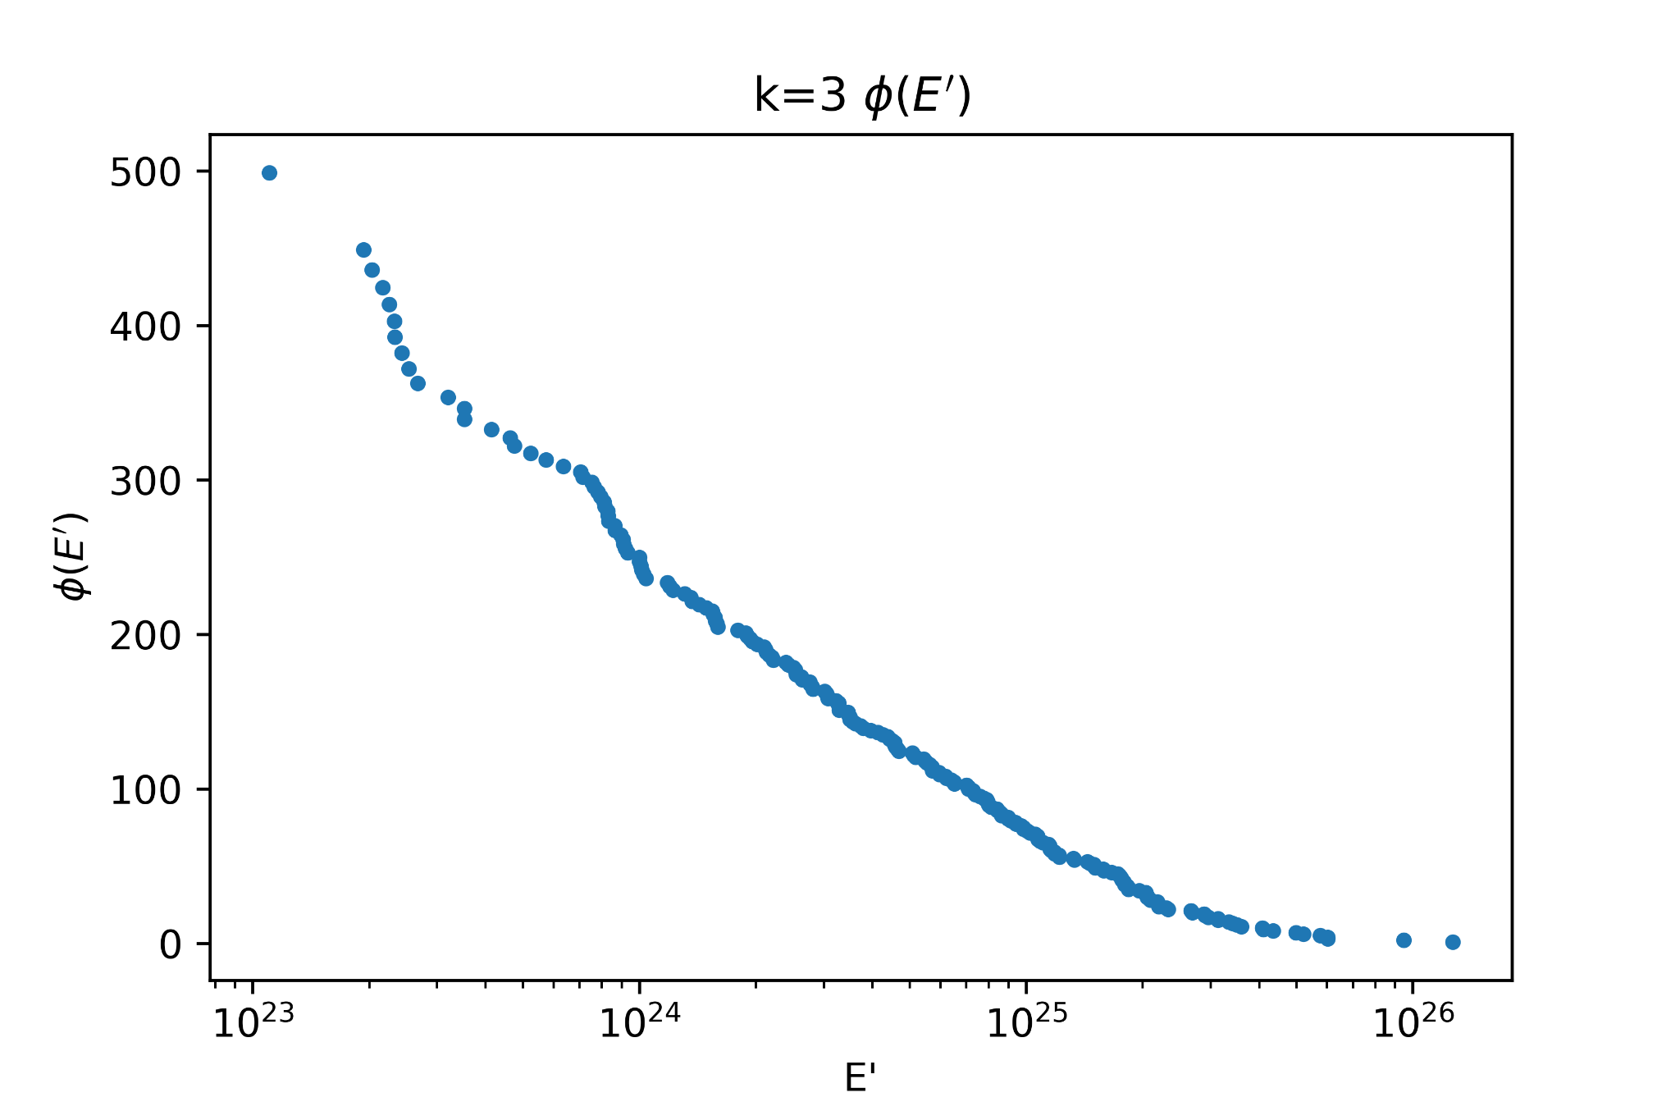
(cont.)
Phi(E’) is shown on the right. The cumulative E’ distribution is approximately a straight line when E’ is shown in logspace, which is to be expected, as the E distribution was a random distribution in log E.

Slide 8
k=4 data

Slide 9
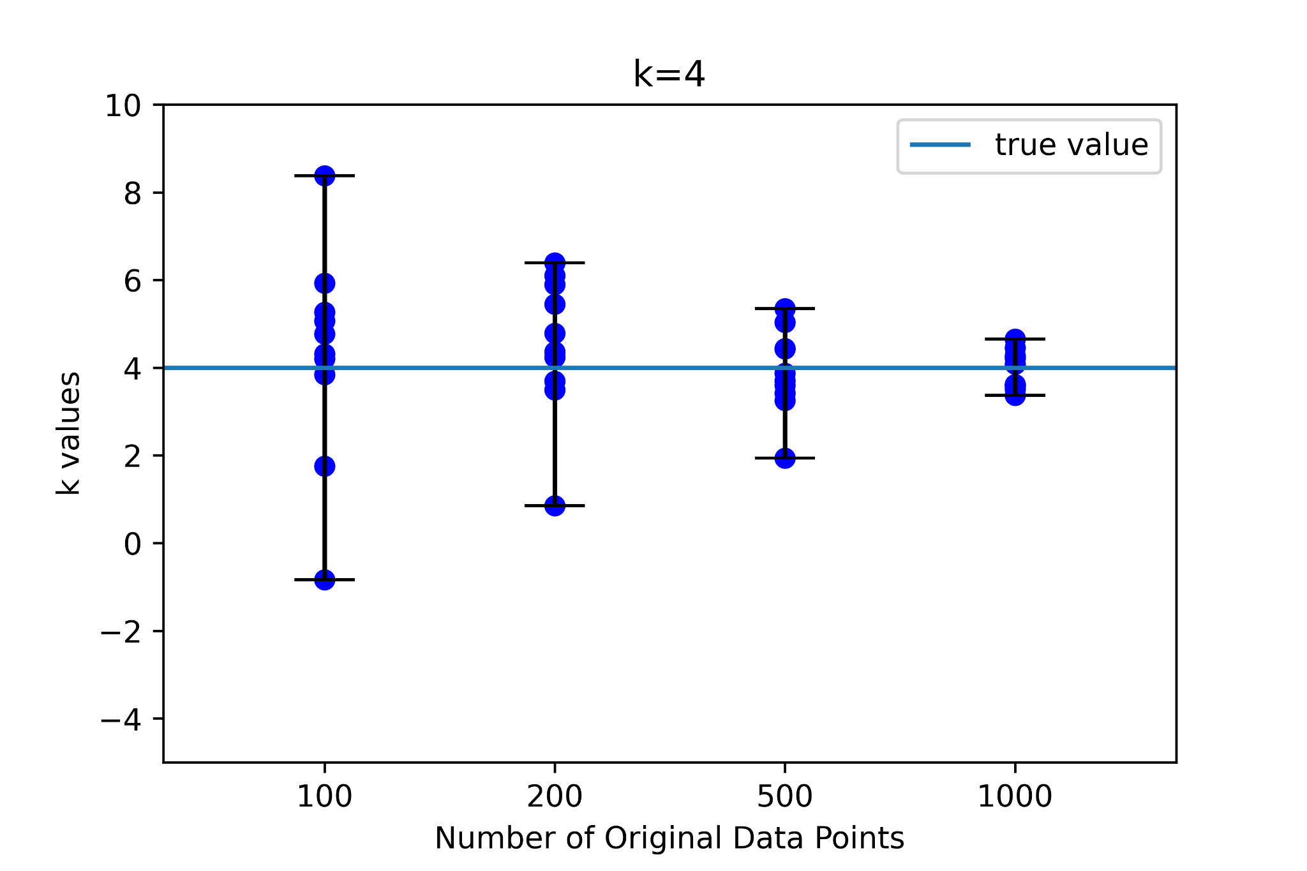
k=4 samples
A set of 10 random samples were run with lognormal distributions in z, and log random distributions in E, for original number of data points 100, 200, 500, and 1000. The resultant k values compared to true values are shown on the right.

Slide 10
How many k values obtained by Kendall Tau are greater than raw fit?
For k=4:
sample size 100: 2/10
sample size 200: 3/10
sample size 500: 0/10
sample size 1000: 0/10

Slide 11
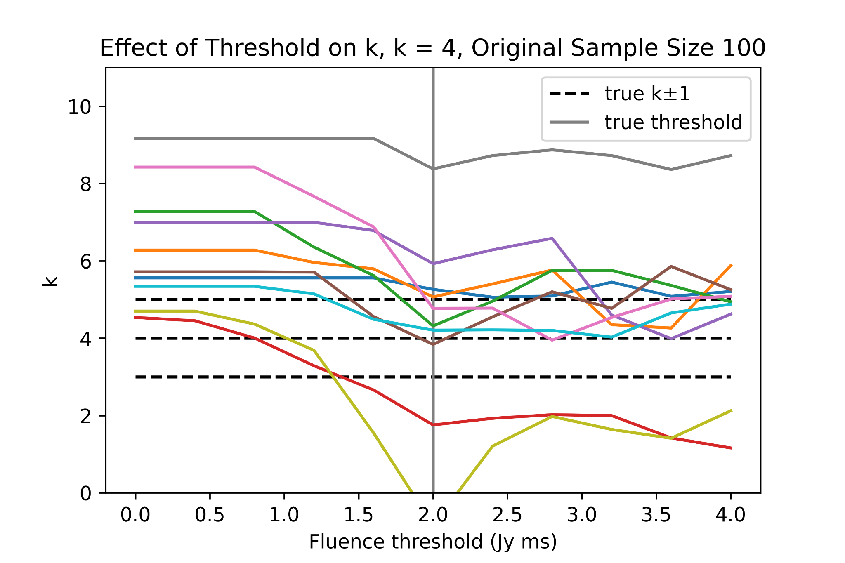
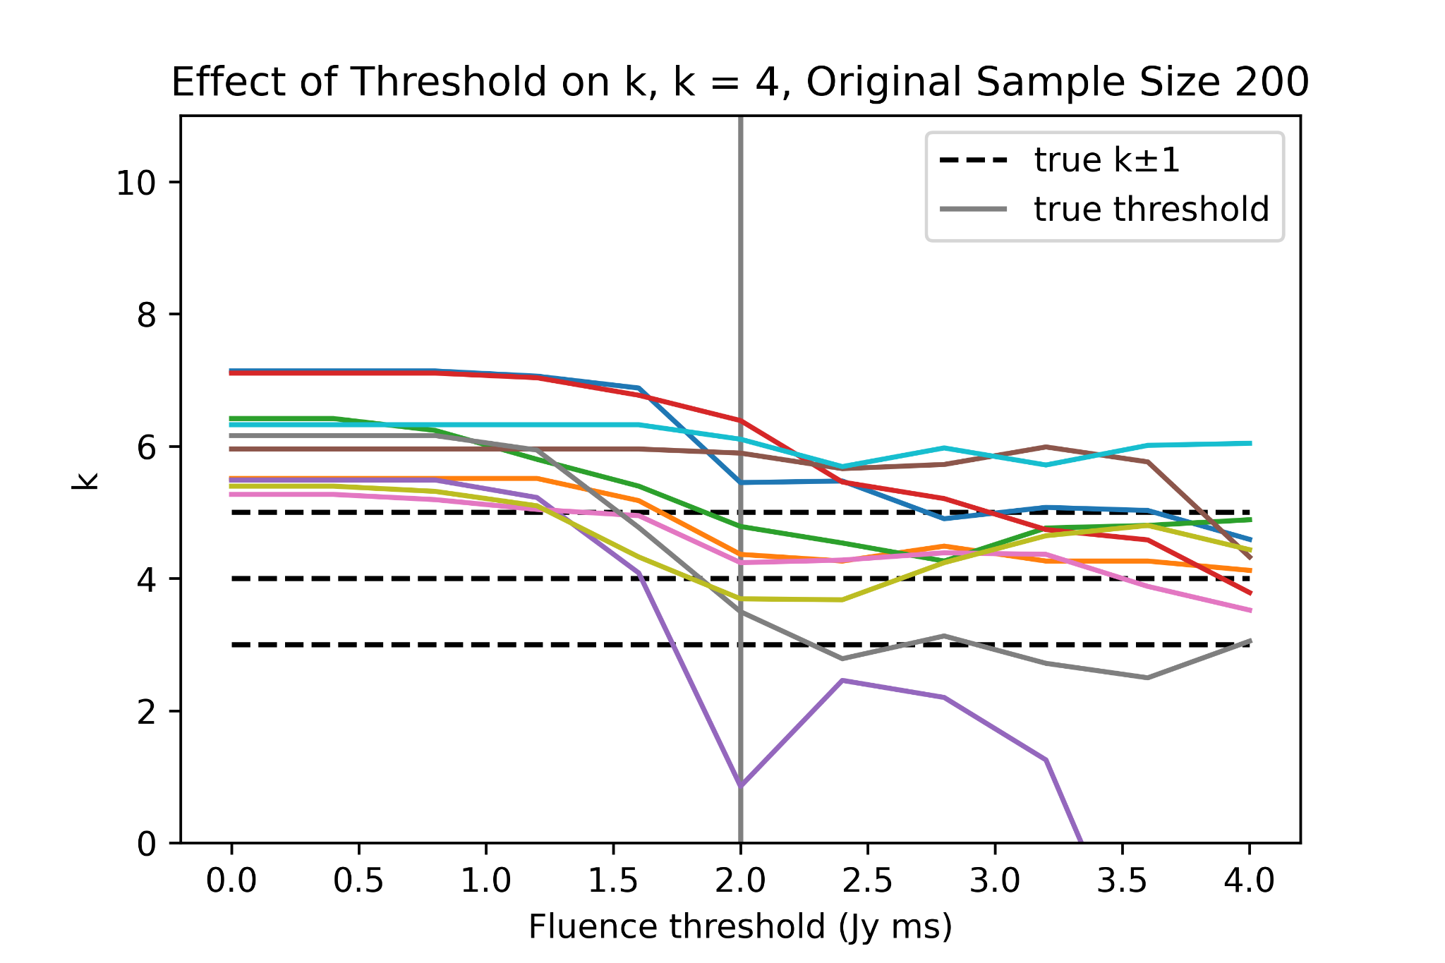
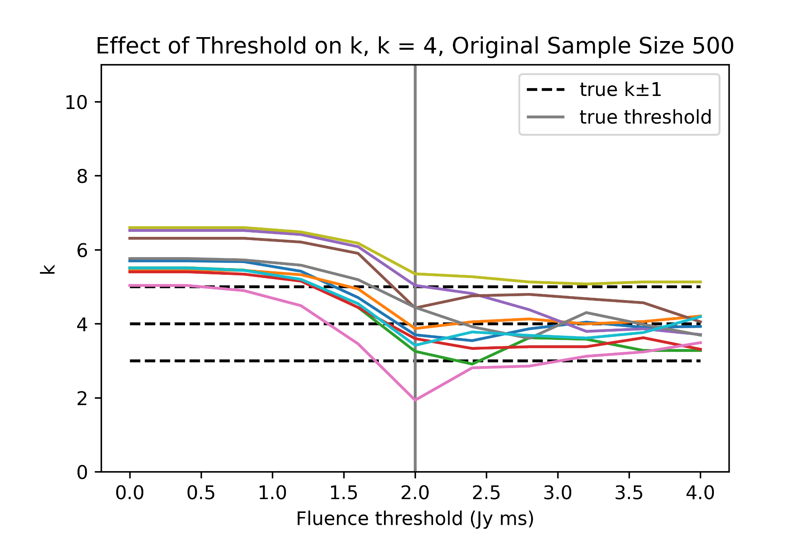
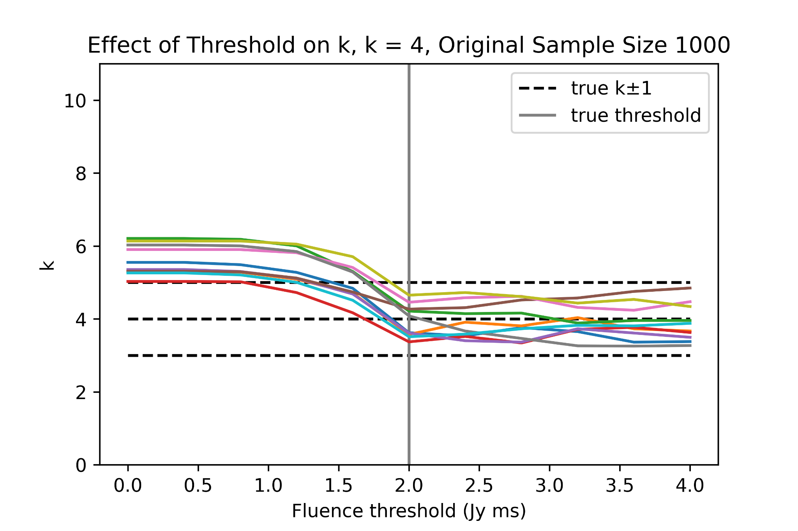
2. Assuming a lower fluence threshold, when does the result become unacceptable?
For k=4:
For each sample size, the threshold was varied to see the variation in k. Generally, higher fluence thresholds than the true value preserve k but lower values result in increasing k, becoming unreasonable at around 1.5 Jy ms.

Slide 12
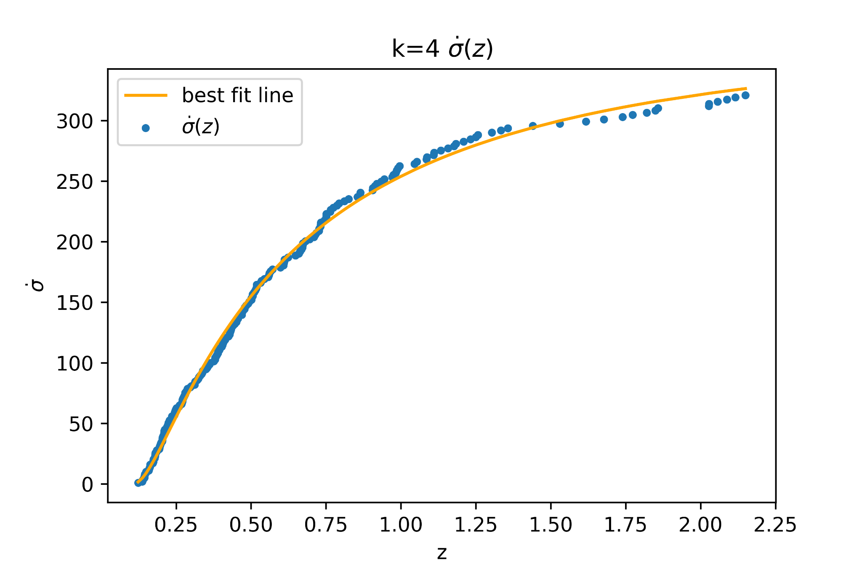
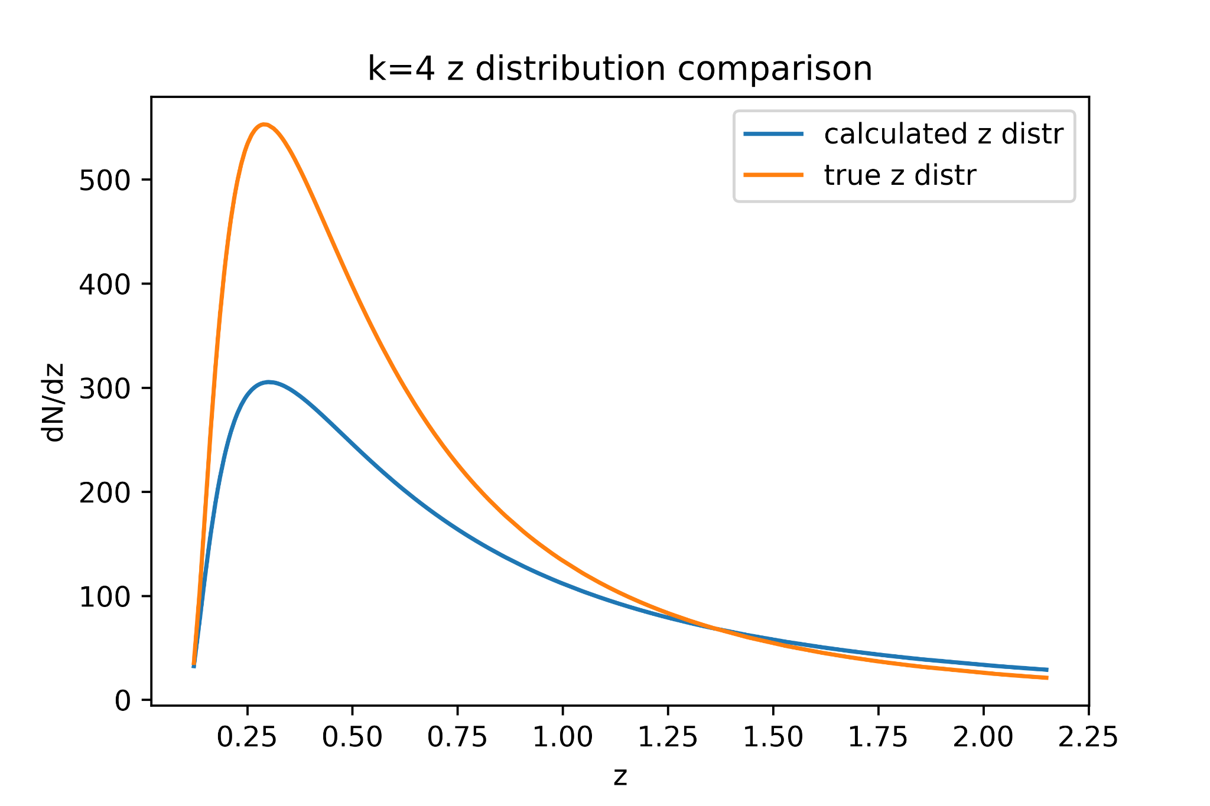
3. How does calculated z, E distributions compare?
Here, one sample of 500 original data points was further analyzed to determine the z and E distributions. Below, the z distribution is pretty similar in shape, and only different in scale (the calculated distribution predicts significantly less total points than the true distribution).

Slide 13
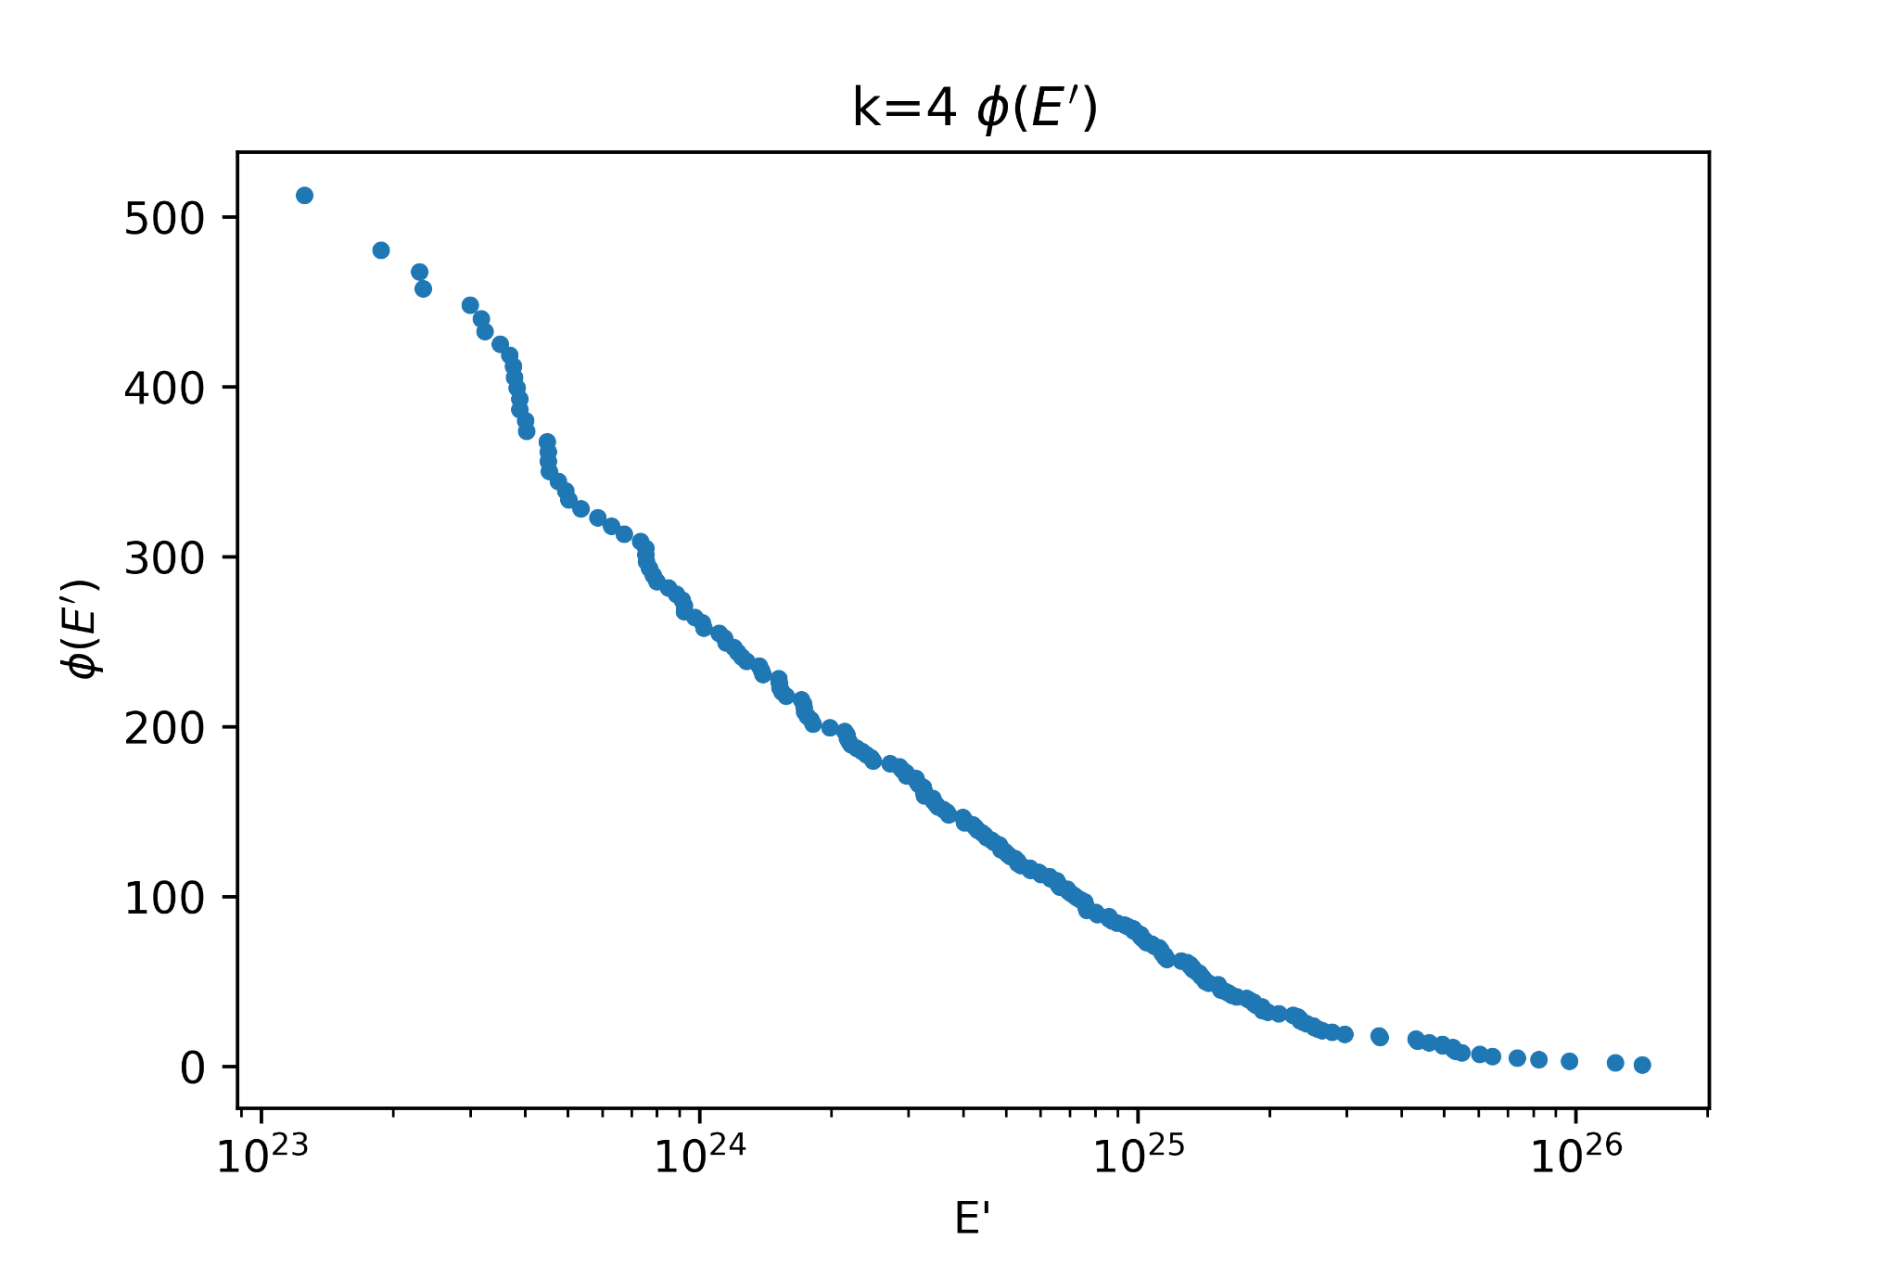
(cont.)
Phi(E’) is shown on the right. The cumulative E’ distribution is approximately a straight line when E’ is shown in logspace, which is to be expected, as the E distribution was a random distribution in log E.

Slide 14
k=5 data

Slide 15
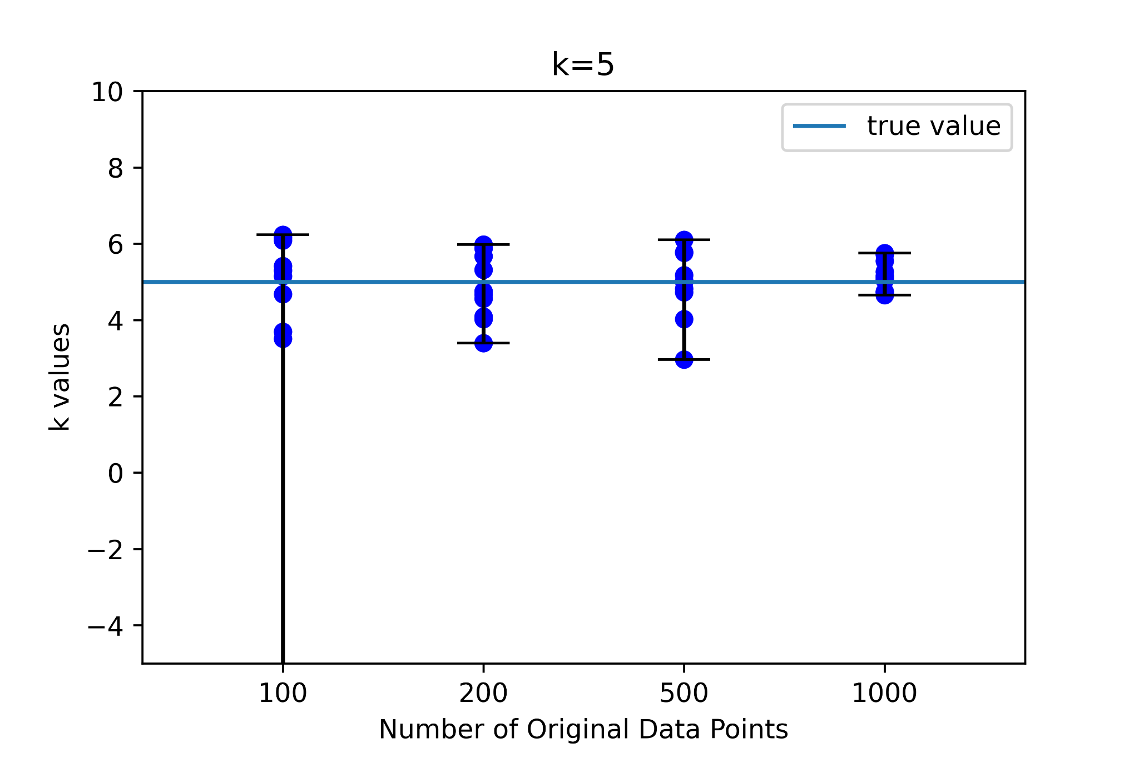
k=5 samples
A set of 10 random samples were run with lognormal distributions in z, and log random distributions in E, for original number of data points 100, 200, 500, and 1000. The resultant k values compared to true values are shown on the right.

Slide 16
How many k values obtained by Kendall Tau are greater than raw fit?
For k=5:
sample size 100: 3/10
sample size 200: 1/10
sample size 500: 3/10
sample size 1000: 2/10

Slide 17
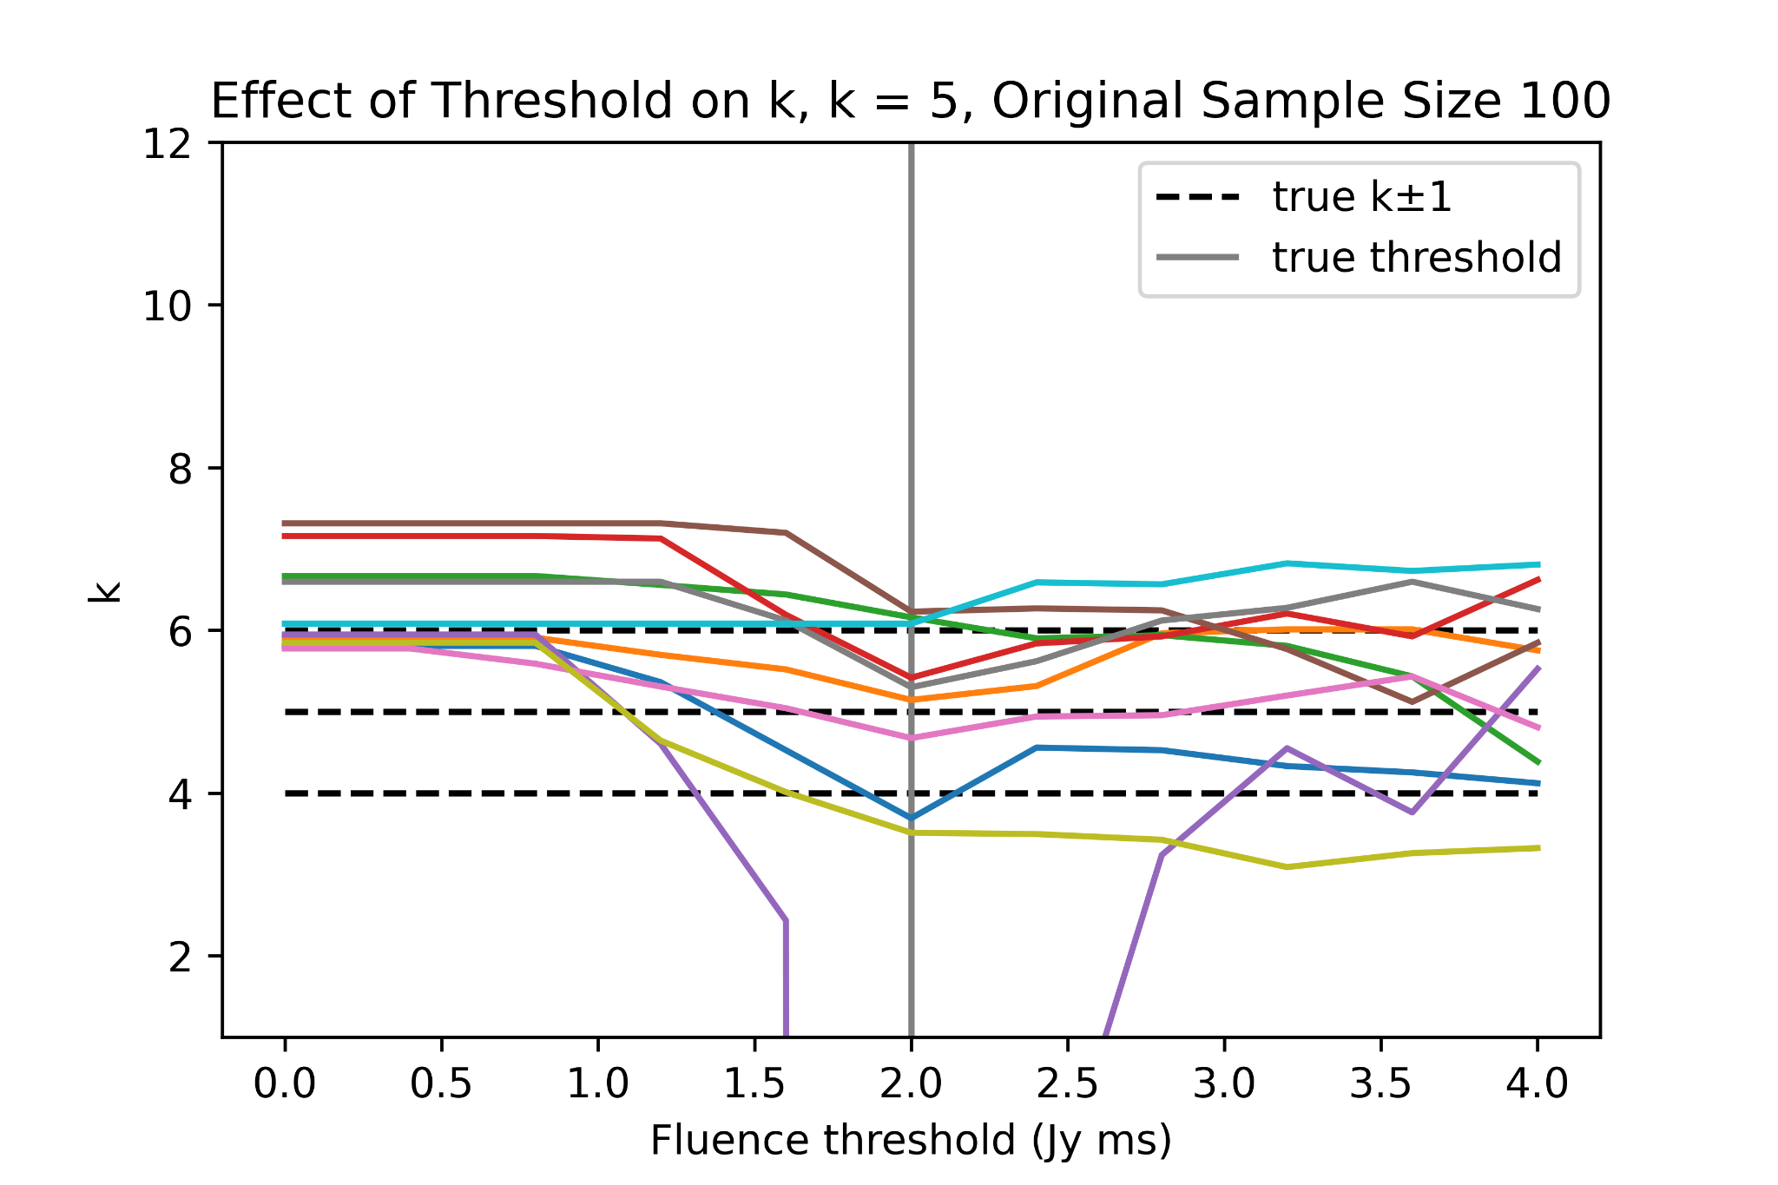
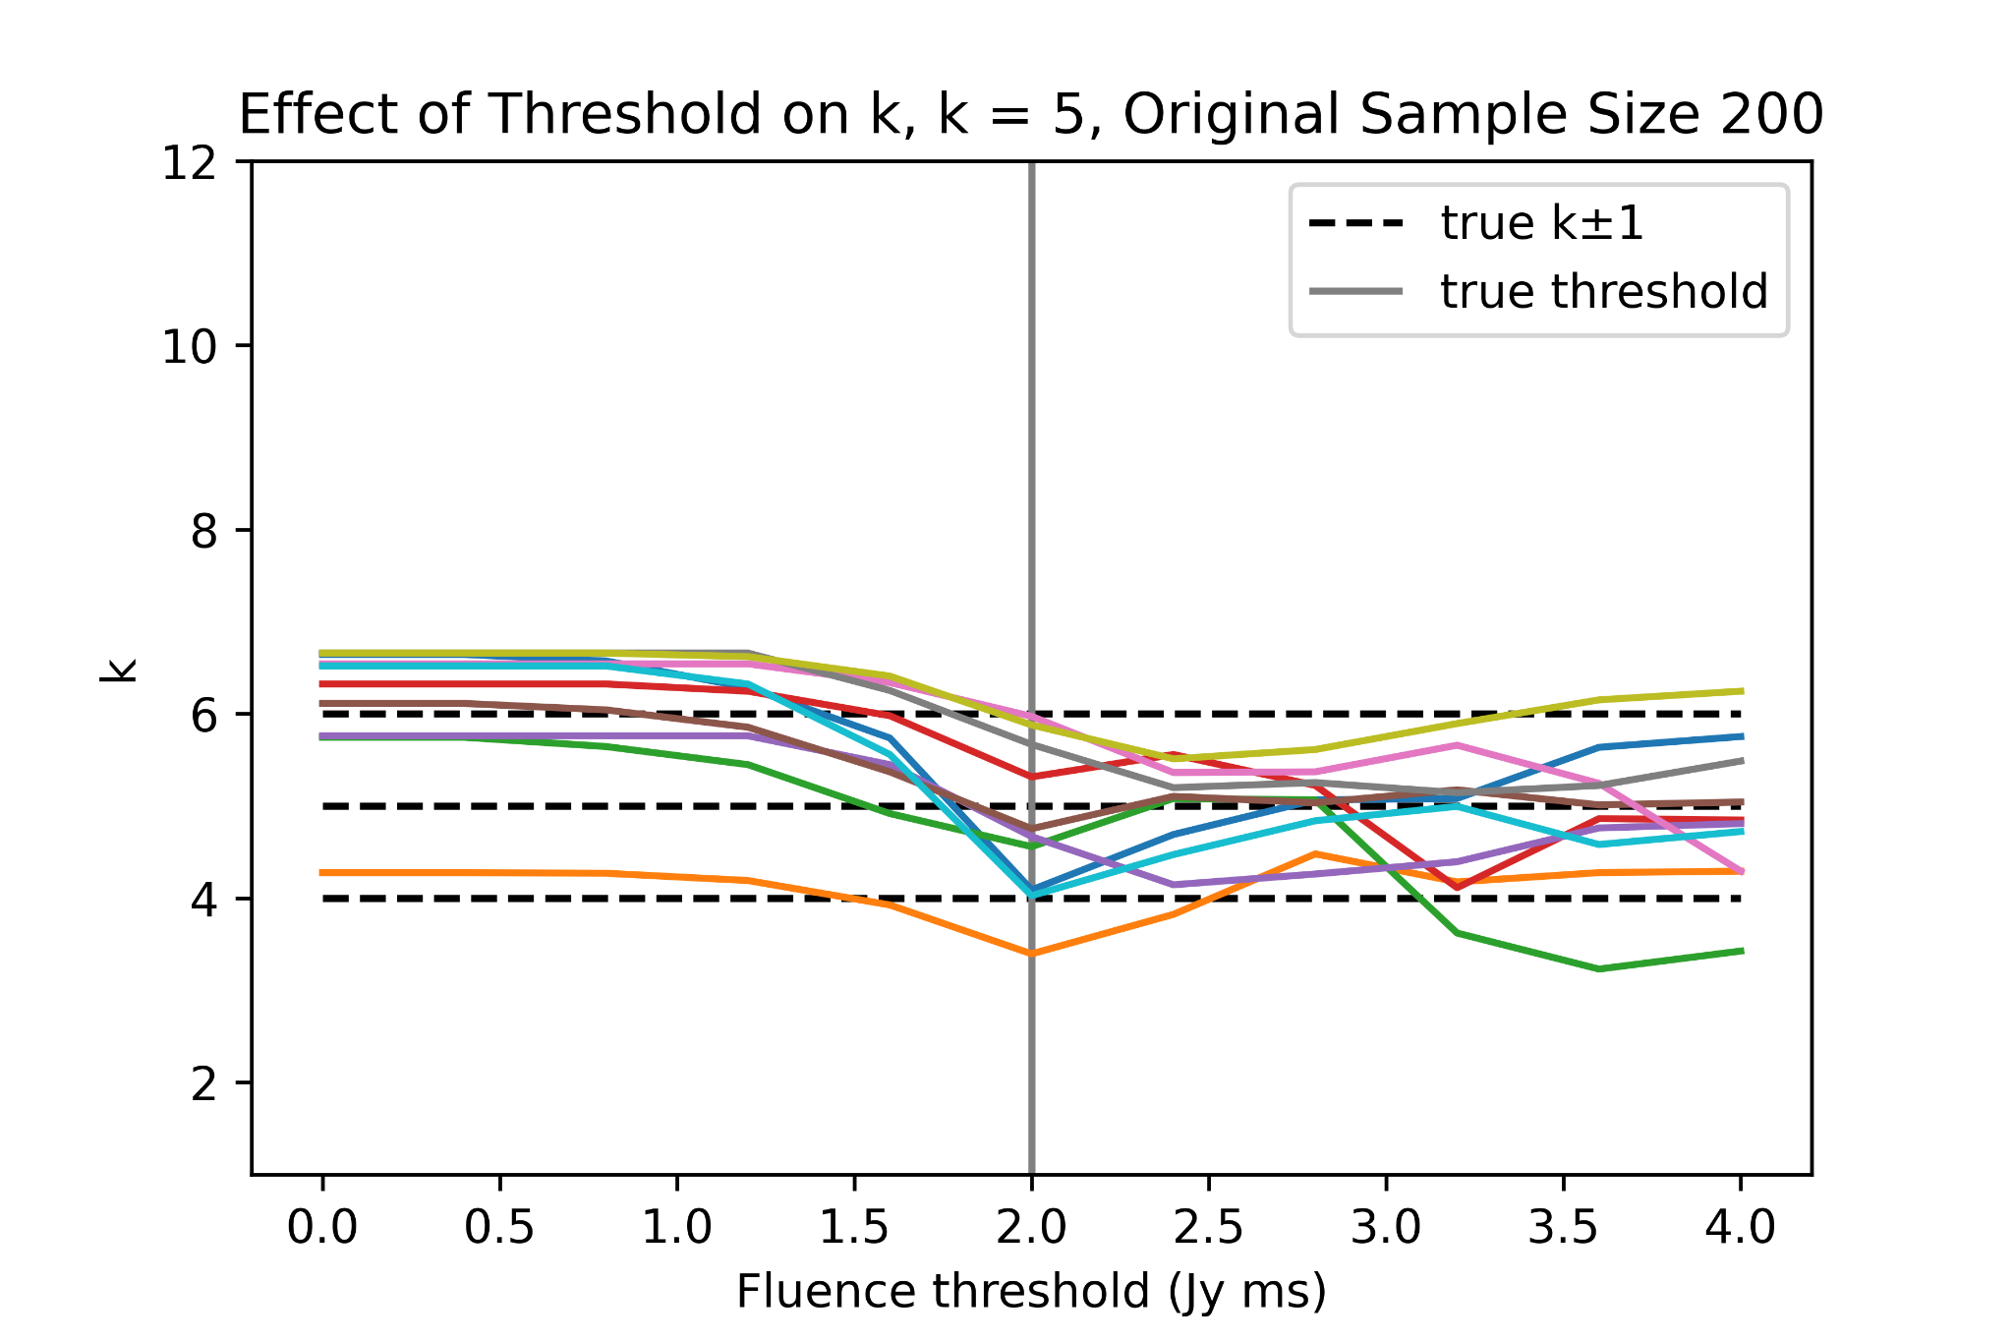
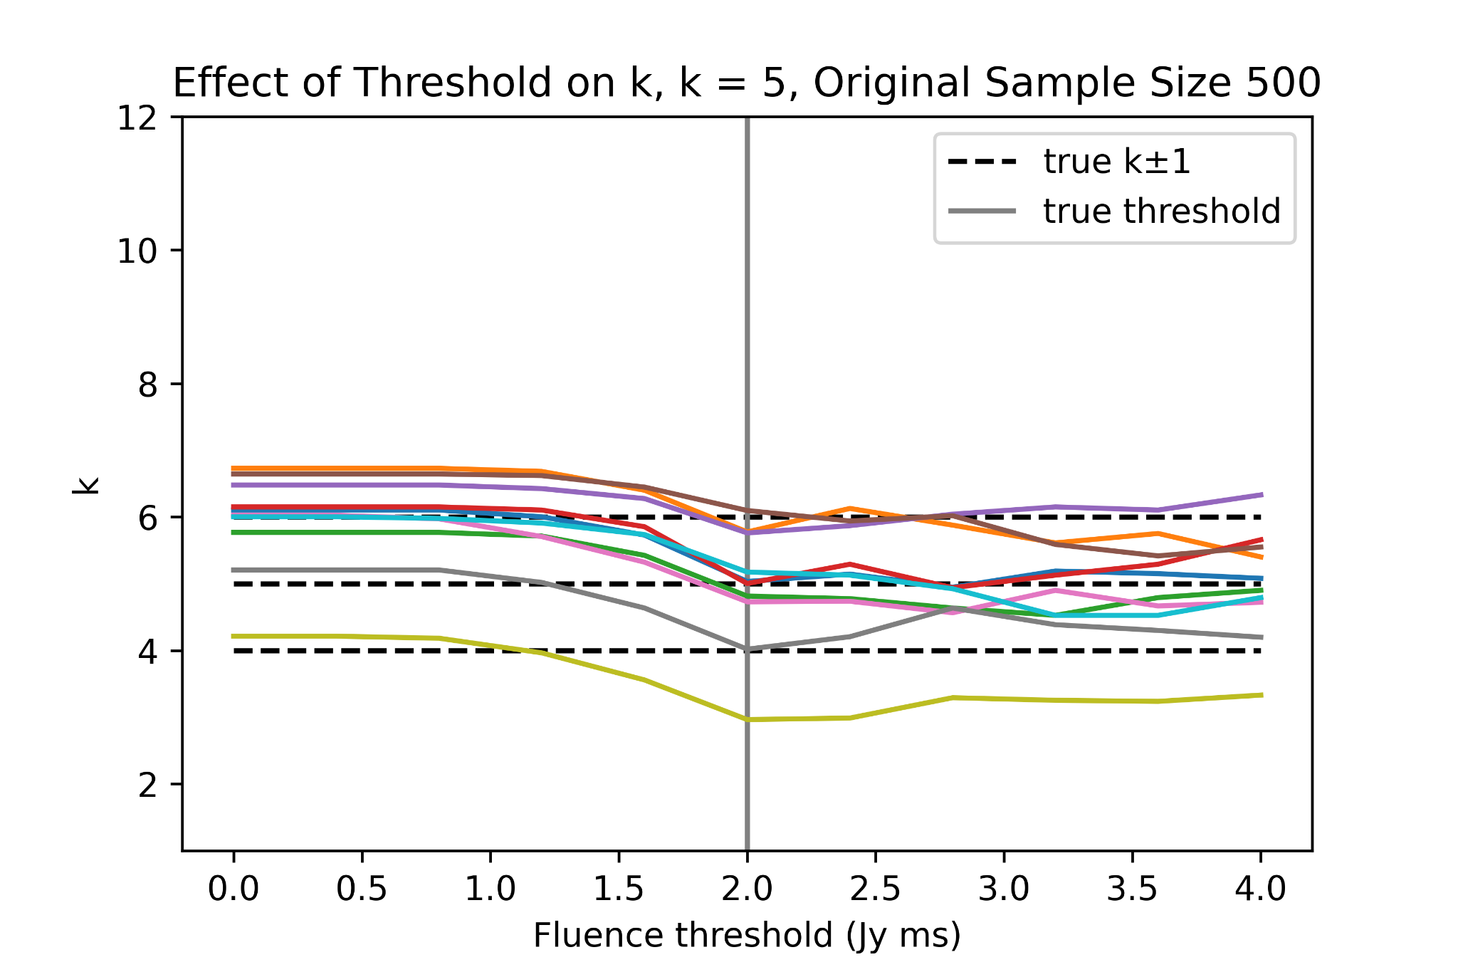
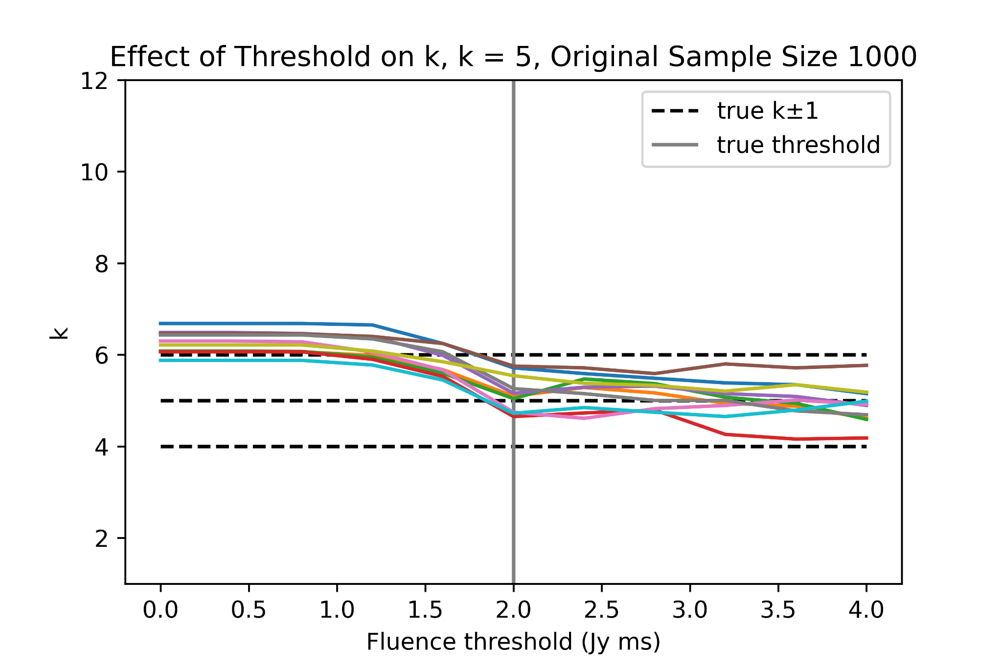
2. Assuming a lower fluence threshold, when does the result become unacceptable?
For k=5:
For each sample size, the threshold was varied to see the variation in k. Generally, higher fluence thresholds than the true value preserve k but lower values result in increasing k, becoming unreasonable at around 1.5 Jy ms.

Slide 18
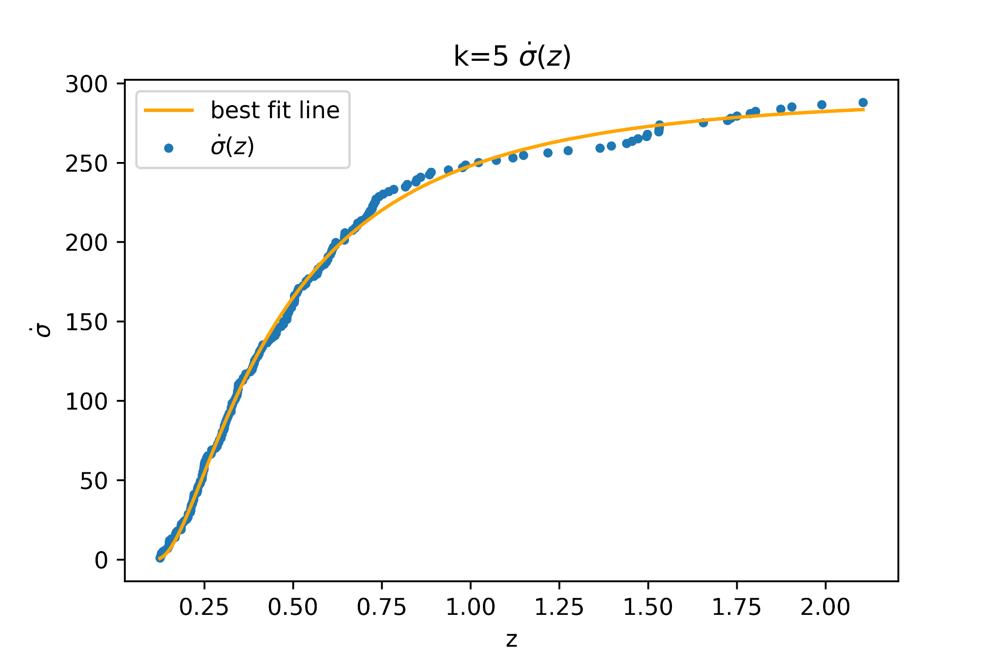
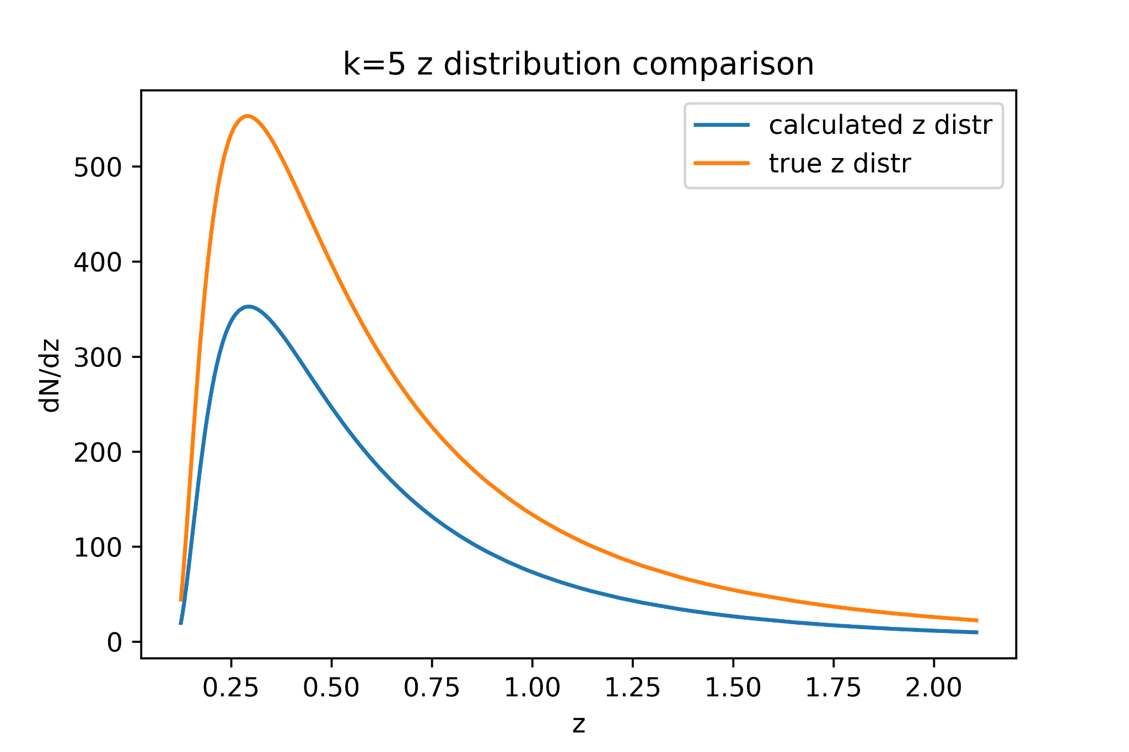
3. How does calculated z, E distributions compare?
Here, one sample of 500 original data points was further analyzed to determine the z and E distributions. Below, the z distribution is pretty similar in shape, and only different in scale (the calculated distribution predicts significantly less total points than the true distribution).

Slide 19
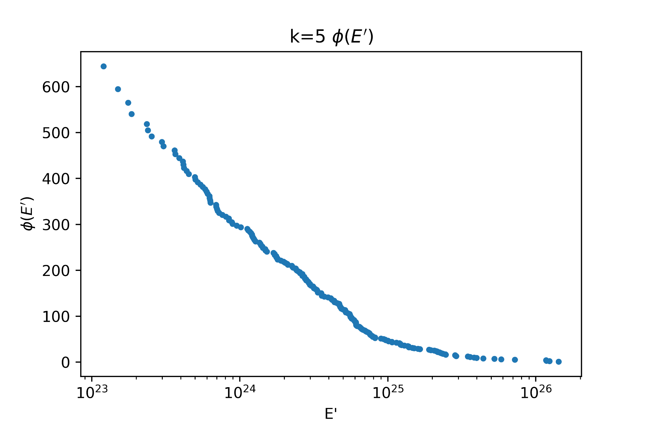
(cont.)
Phi(E’) is shown on the right. The cumulative E’ distribution is approximately a straight line when E’ is shown in logspace, which is to be expected, as the E distribution was a random distribution in log E.

